Slide 1
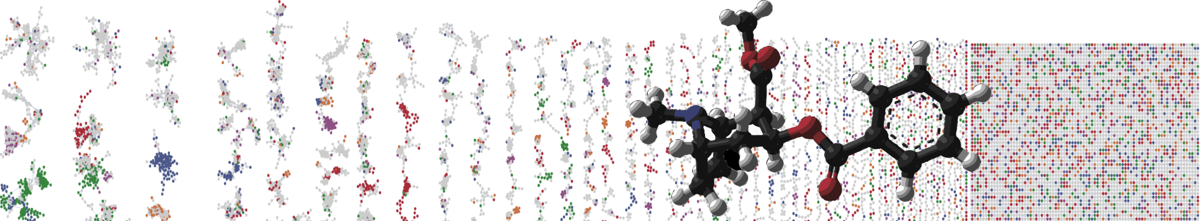


GNPS Classic Molecular Networking Overview
Lecture
ENTER AUTHORS HERE
University of California - San Diego

Slide 2
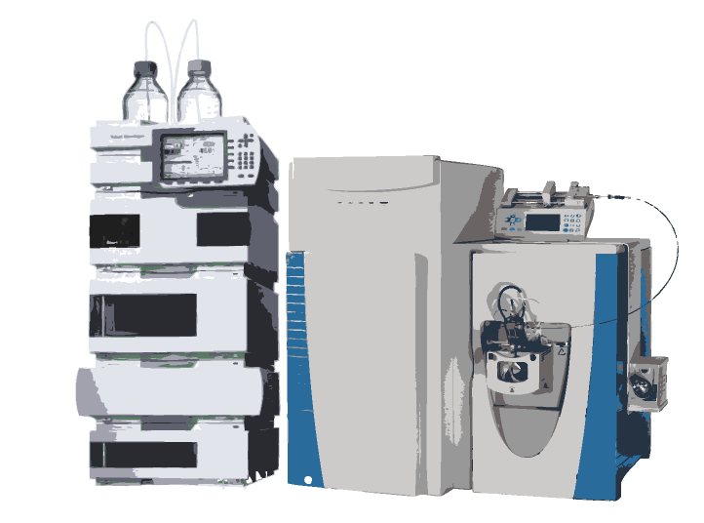
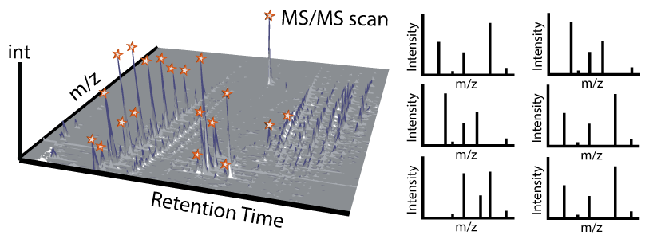
Global Metabolomics Acquisition and Analysis
METABOLOME
UHPLC-MS/MS
DATA
LC-MS¹
MS/MS spectra
Notes:
As MS fragmentation of each individual molecule results in a unique MS/MS fingerprint, we decided to develop network-based workflows to organize large data sets of tandem mass spectra based on the similarity between fragmentation patterns of different, but related, precursor ions. By using a variation of spectral networks designed for proteomic applications, the data are initially simplified by forming consensus spectra whereby identical spectra exhibiting identical precursor ion mass-to-charge ratios (m/z) and fragmentation patterns are merged

Slide 3
What to do with
these fragmentation spectra ?!
m/z
m/z
m/z
m/z
Library match
m/z
m/z
m/z
Notes:
As MS fragmentation of each individual molecule results in a unique MS/MS fingerprint, we decided to develop network-based workflows to organize large data sets of tandem mass spectra based on the similarity between fragmentation patterns of different, but related, precursor ions. By using a variation of spectral networks designed for proteomic applications, the data are initially simplified by forming consensus spectra whereby identical spectra exhibiting identical precursor ion mass-to-charge ratios (m/z) and fragmentation patterns are merged
General workflow to characterize microbial metabolic profiles. Bacteria were cultured, and the tandem MS spectra of metabolites were collected. Spectra were aligned with the cosine scores calculating similarity with ‘1’ indicating identical spectra and ‘0’ no similarity at all. A molecular network was thus generated with each node representing a unique spectrum and the thickness of edge representing the cosine score. The spectra that correlated to interesting nodes/subnetworks were subjected to sequence tagging and to query against the genome to identify biosynthetic gene subnetworks. By this process, the structures of molecules were predicted or identified with the information from both MS spectra and genomic information.
Mapping the molecular network through MS/MS networking and peptidogenomics to reveal the rich metabolic potential of Streptomyces roseosporus. Data sets containing MS/MS spectra collected from S. roseosporus extract were subjected to MS/MS networking analysis and revealed several groups of highly subnetworked ions.

Slide 4
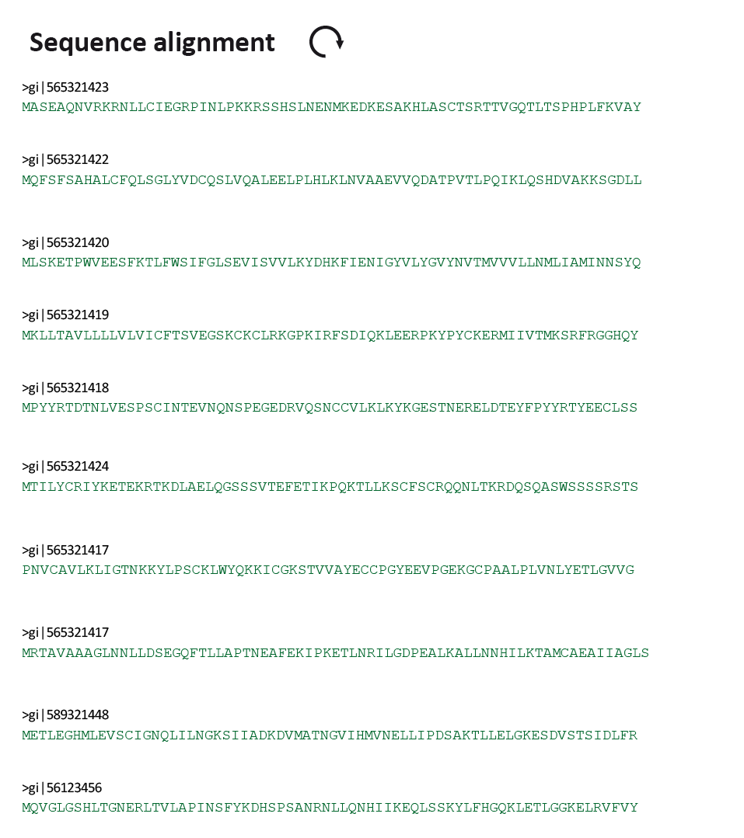
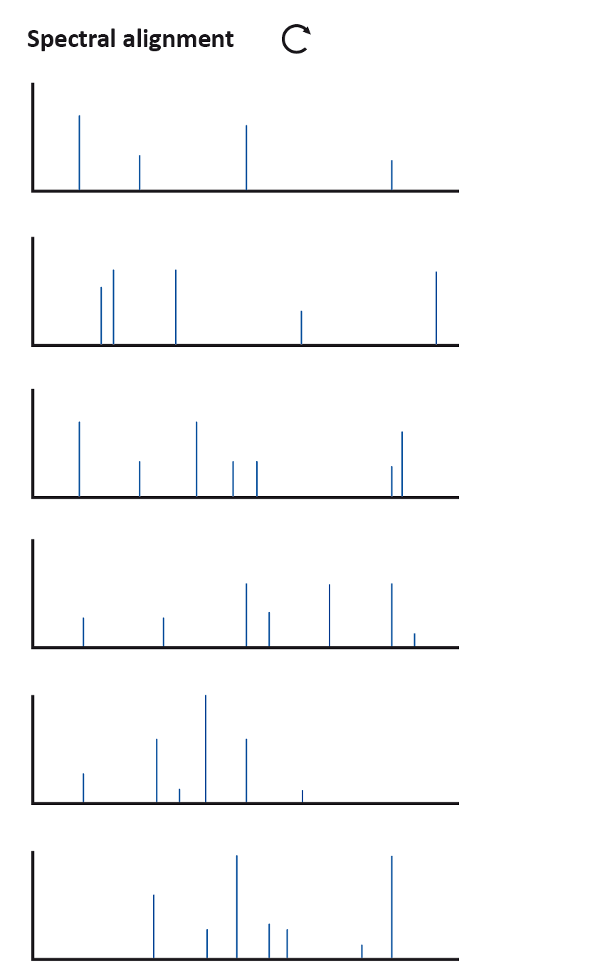
Spectrum Library Matching
Spectral Similarity is defined through “Cosine Score”
Cosine Score -> 0-1
0 -> no similarity
1 -> identical

Slide 5
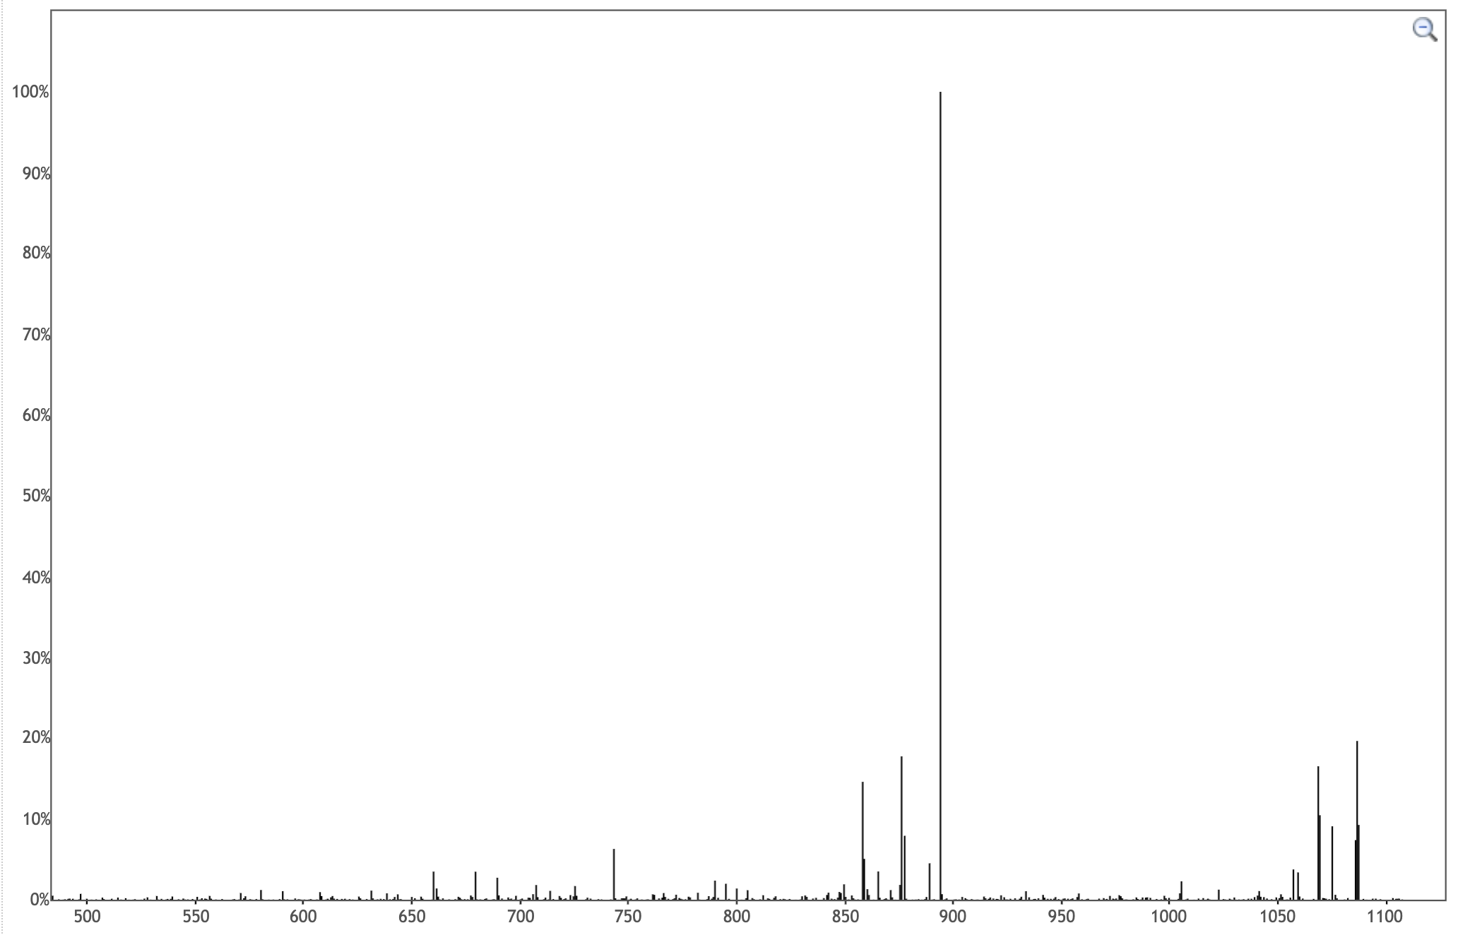
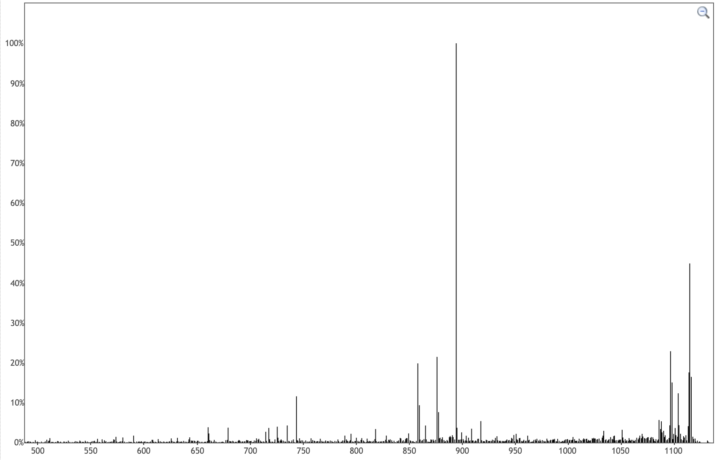
Spectral Similarity
Stenothricin A
m/z 1104.56
Stenothricin C
m/z 1132.59
Similar Structure
MS/MS
MS/MS
894
894
1114
1086
876
876
1096
859
858
1069
Similar
Spectrum
743
1103
894
1075
Notes:
https://gnps.ucsd.edu/ProteoSAFe/gnpslibraryspectrum.jsp?SpectrumID=CCMSLIB00000075070
https://gnps.ucsd.edu/ProteoSAFe/gnpslibraryspectrum.jsp?SpectrumID=CCMSLIB00000075068

Slide 6
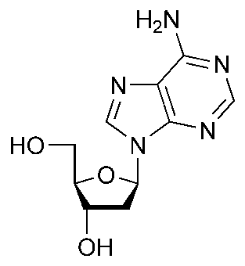



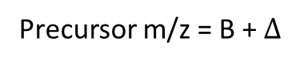
Matching Two MS/MS Spectra Analog Tolerant
int
Precursor m/z = B
m/z
$$Δ$$
int
Precursor m/z = B + $Δ$
m/z
$$Δ$$
$$Δ$$
Watrous, Jeramie, et al. "Mass spectral molecular networking of living microbial colonies." Proceedings of the National Academy of Sciences 109.26 (2012): E1743-E1752.

Slide 7

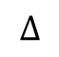
Matching Two MS/MS Spectra Analog Tolerant
int
int
m/z
m/z
int
int
m/z
m/z
$$Δ$$
$$Δ$$
$$Δ$$
$$Δ$$

Slide 8
Matching Two MS/MS Spectra Analog Tolerant
int
int
m/z
m/z
int
int
m/z
m/z
$$Δ$$
$$Δ$$
$$Δ$$
$$Δ$$

Slide 9


Matching Two MS/MS Spectra Analog Tolerant
int
Precursor m/z = B
m/z
Maximize Score over all possible alignments
int
Precursor m/z = B + $Δ$
m/z
$$Δ$$
$$Δ$$

Slide 10
Molecular Networking
MS/MS
Vector-based spectral matching
m/z
m/z
m/z
m/z
Library match
m/z
m/z
m/z
Notes:
As MS fragmentation of each individual molecule results in a unique MS/MS fingerprint, we decided to develop network-based workflows to organize large data sets of tandem mass spectra based on the similarity between fragmentation patterns of different, but related, precursor ions. By using a variation of spectral networks designed for proteomic applications, the data are initially simplified by forming consensus spectra whereby identical spectra exhibiting identical precursor ion mass-to-charge ratios (m/z) and fragmentation patterns are merged
General workflow to characterize microbial metabolic profiles. Bacteria were cultured, and the tandem MS spectra of metabolites were collected. Spectra were aligned with the cosine scores calculating similarity with ‘1’ indicating identical spectra and ‘0’ no similarity at all. A molecular network was thus generated with each node representing a unique spectrum and the thickness of edge representing the cosine score. The spectra that correlated to interesting nodes/subnetworks were subjected to sequence tagging and to query against the genome to identify biosynthetic gene subnetworks. By this process, the structures of molecules were predicted or identified with the information from both MS spectra and genomic information.
Mapping the molecular network through MS/MS networking and peptidogenomics to reveal the rich metabolic potential of Streptomyces roseosporus. Data sets containing MS/MS spectra collected from S. roseosporus extract were subjected to MS/MS networking analysis and revealed several groups of highly subnetworked ions.

Slide 11
Molecular Networking
MS/MS
Vector-based spectral matching
Molecular networks
D
0.7
E
A
Δ = 2 Da
D
A
G
0.9
B
B
0.2
0.3
F
0.2
C
Δ = 14 Da
0.7
C
F
Library match
E
0.9
Visualizing spectral families
G
Propagation of spectral annotation
Watrous, J. et al. (2012) Mass spectral molecular networking of living microbial colonies. Proc. Natl. Acad. Sci. U. S. A. 109, 1743–52
Notes:
As MS fragmentation of each individual molecule results in a unique MS/MS fingerprint, we decided to develop network-based workflows to organize large data sets of tandem mass spectra based on the similarity between fragmentation patterns of different, but related, precursor ions. By using a variation of spectral networks designed for proteomic applications, the data are initially simplified by forming consensus spectra whereby identical spectra exhibiting identical precursor ion mass-to-charge ratios (m/z) and fragmentation patterns are merged
General workflow to characterize microbial metabolic profiles. Bacteria were cultured, and the tandem MS spectra of metabolites were collected. Spectra were aligned with the cosine scores calculating similarity with ‘1’ indicating identical spectra and ‘0’ no similarity at all. A molecular network was thus generated with each node representing a unique spectrum and the thickness of edge representing the cosine score. The spectra that correlated to interesting nodes/subnetworks were subjected to sequence tagging and to query against the genome to identify biosynthetic gene subnetworks. By this process, the structures of molecules were predicted or identified with the information from both MS spectra and genomic information.
Mapping the molecular network through MS/MS networking and peptidogenomics to reveal the rich metabolic potential of Streptomyces roseosporus. Data sets containing MS/MS spectra collected from S. roseosporus extract were subjected to MS/MS networking analysis and revealed several groups of highly subnetworked ions.

Slide 12
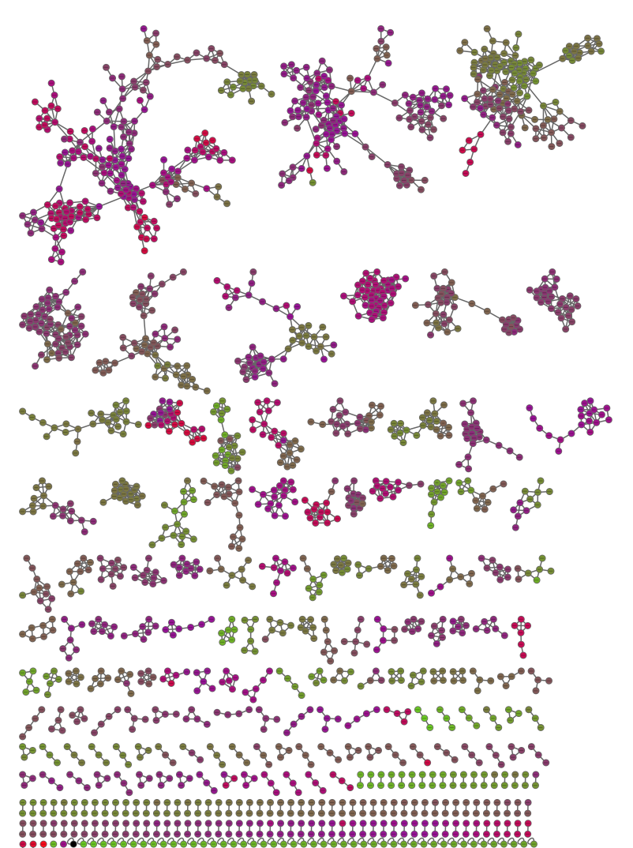
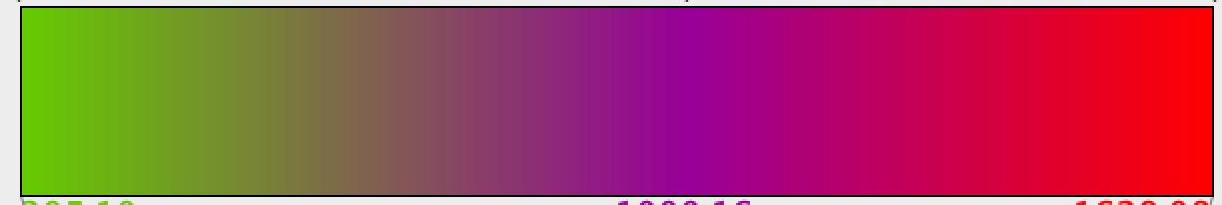
Molecular Networking
Actinomycetes example
m/z 2000
Desferrioxamine B
Nonactins
m/z 200
Acyl desferrioxaminC13-C14
Asteroidean
Valinomycin
Ferrioxamines
ActinomycinD
Streptorubin
Undecylprodiginine
DesferrioxamineE
Glucopiericidins

Slide 13
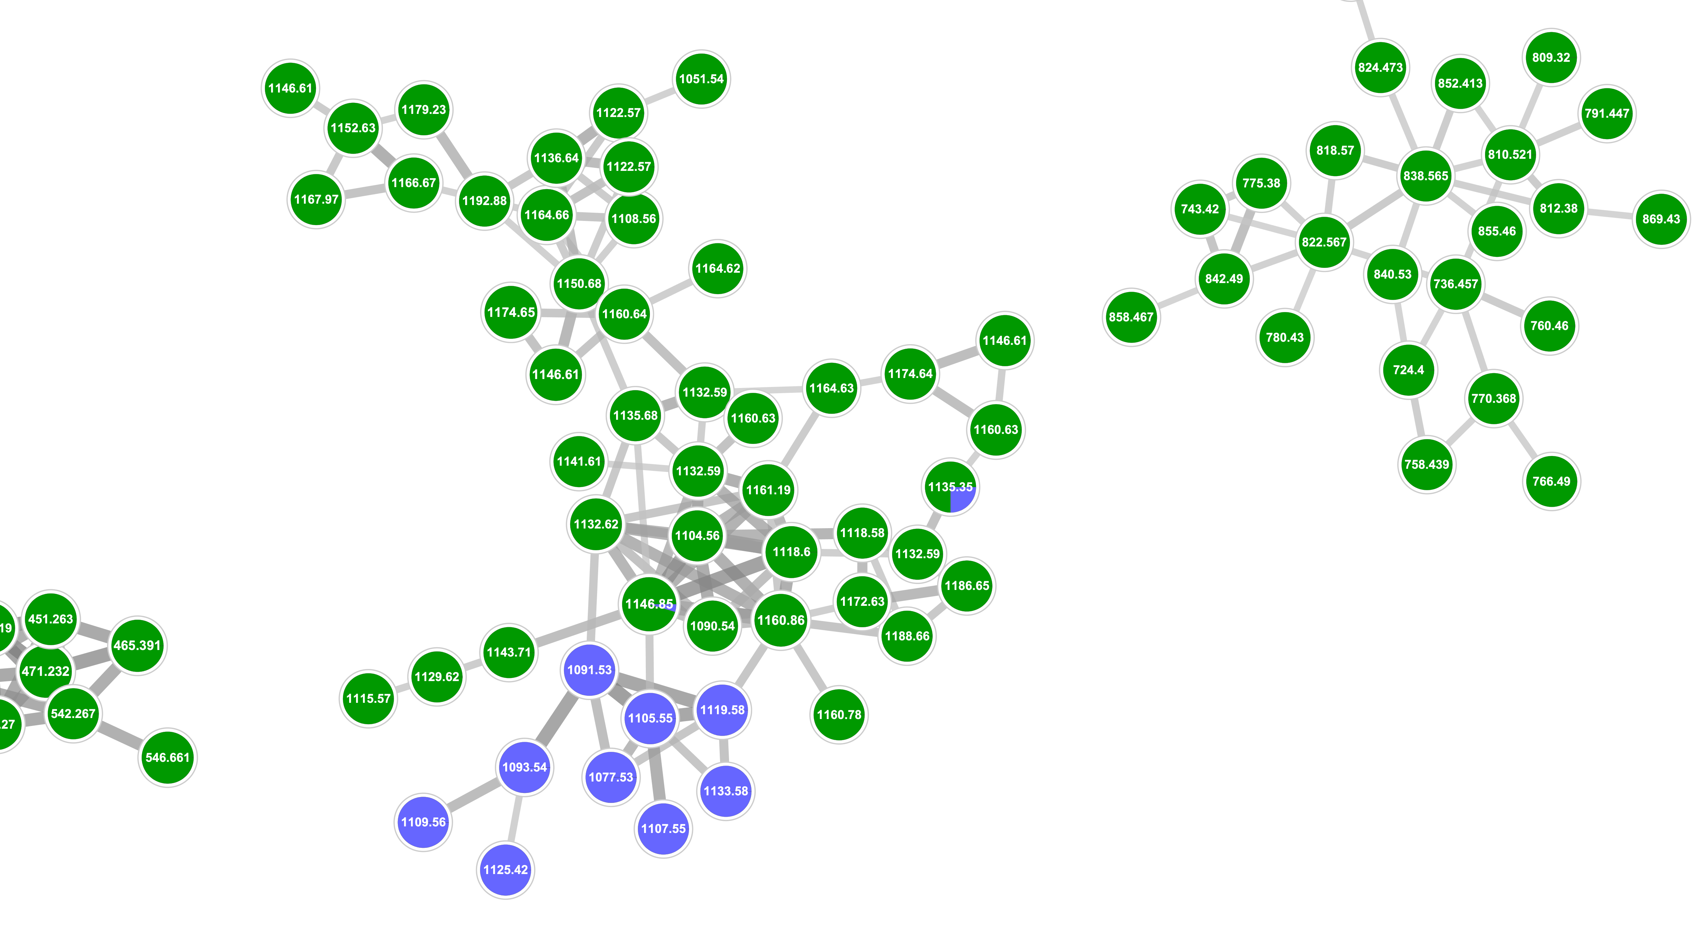
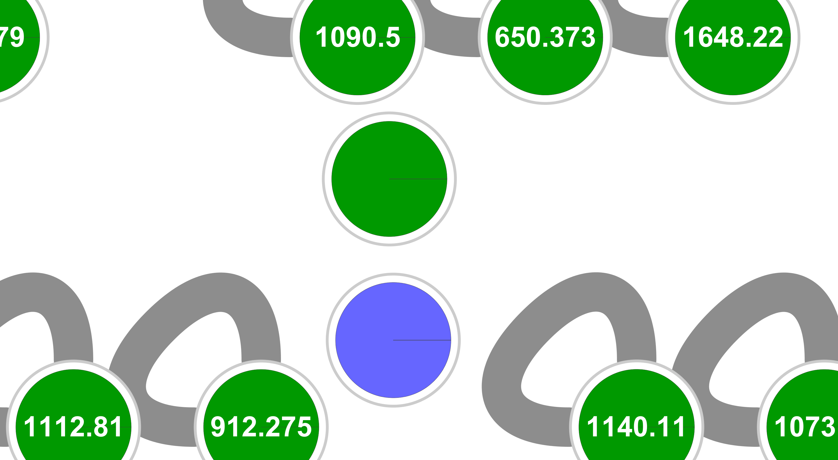
Discovering New Molecules with Molecular Networking
Δ m/z 41
Stenothricin C
m/z 1132.62
Stenothricin GNPS 2
m/z 1091.53
Δ m/z 41
Streptomyces roseosporus NRRL 15998
Streptomyces sp. DSM5940
GNPS Task Link

